Slide 1
Flight Software (FSW) Design Master Slide
GS
Guide Slides

Slide 2
What is this presentation?
It is a detailed analysis of the FSW section of the previous year winners.
FSW can be divided into 5 parts and each part is analysed in the following slides.
Each part includes:
Basic guide slide provided by the Competition
Slides of the 3 teams for reference
Summary outlining the steps to be taken and the necessary prerequisites which has to be satisfiedn before the work for each part can begin.
Legend:
Any Slide with GS in the top right corner is a Guide Slide, either created by me or provided by the Competition.
All text in PURPLE is a comment, specifying which particular guidelines mentioned in the GS are satisfied in the particular slide.
Do go through everything and enquire if you have any doubts.

Slide 3
Part 1: FSW Overview
GS
Overview of the CanSat FSW design
Should discuss
Basic FSW architecture, a flow chart showing how the software flow
Programming languages
Development environments
Brief summary of the FSW tasks

Slide 4


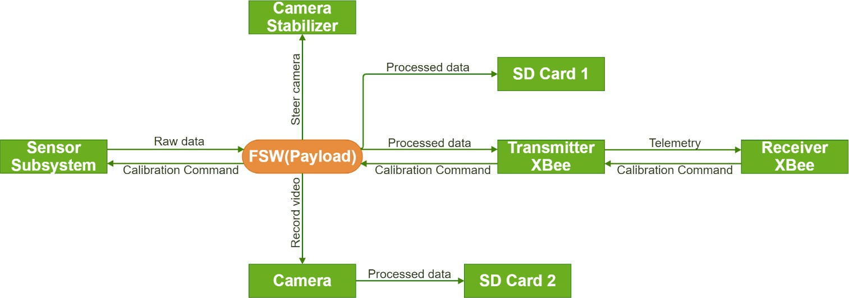
FSW Overview (1/3)
Team Logo
Here
(If You Want)
Team 1
Basic FSW architecture, a flow chart showing how the software flow
Presenter: Altuğ ERTAN
4

Slide 5
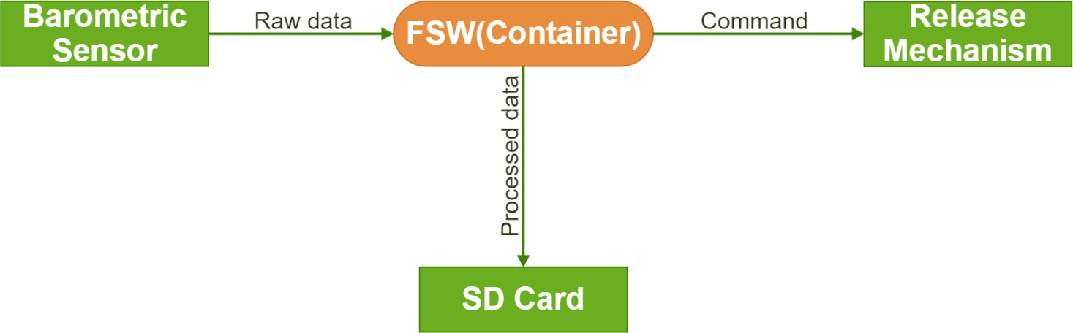
FSW Overview (2/3)
Team Logo
Here
(If You Want)
Team 1
Basic FSW architecture, a flow chart showing how the software flow
Presenter: Altuğ ERTAN
5

Slide 6
FSW Overview (3/3)
Team Logo
Here
(If You Want)
Team 1
Programming Language:
C/C++
Development Environment:
Arduino IDE
Summary of FSW (Payload) Tasks:
To obtain raw data from payload sensors and convert them to processed data
expressed in engineering units.
To command to transmitter XBee for sending telemetry data to receiver XBee at 1 Hz
To command to camera for recording descent of the payload.
To save processed data and video to SD card.
To steer servo and stepper motors which control camera stabilizer according to magnetic north and nadir.
Summary of FSW (Container) Tasks:
Reading altitude value from barometer sensor during flight and carrying out
separation of the payload at 450 meters.
Programming languages
Development environments
Brief summary of the FSW tasks
Presenter: Altuğ ERTAN
6

Slide 7


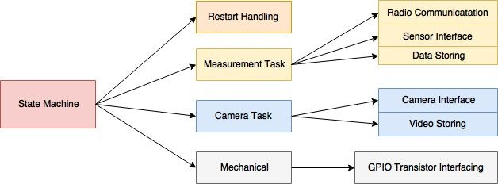
FSW Overview 1/2
Team Logo
Here
(If You Want)
Team 2
Main FSW Assumptions
Flight software will be developed in C++ language.
SW architecture is based on state machine system.
Code will be created and debugged in Eclipse environment, extended by STM processor plugins.
Program flow has to be restart resistant and restore its state in case of such failure.
We distinguished following FSW subtasks:
Basic FSW architecture, a flow chart showing how the software flow
Presenter: Mateusz Rajzer

Slide 8
FSW Overview 2/2
Team Logo
Here
(If You Want)
Team 2
Brief summary of the FSW tasks
Main FSW Operations
On the ground, before start:
Awaiting on arming signal from CGS,
Continuous communication with ground starts now,
Measurement Task is started, measured values are transmitted and also stored on flash memory
After arming operation:
- Probe waiting for release CanSat from the rocket.
When released from rocket:
All previous tasks are maintained.
Video recording is triggered,
CanSat is awaiting for desired altitude.
After critical altitude crossing:
Cansat is being released from container,
Cansat is awaiting for landing.
After landing:
Camera and measurement operations will be no longer performed,
Buzzer signalization starts, and transmission stops.
Presenter: Mateusz Rajzer

Slide 9


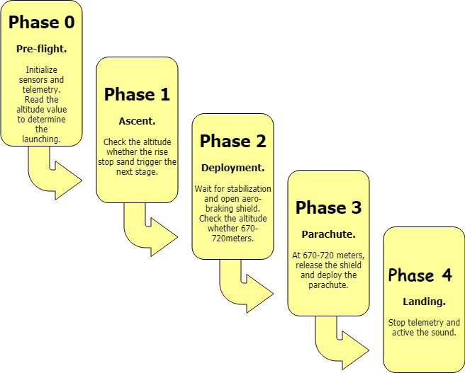
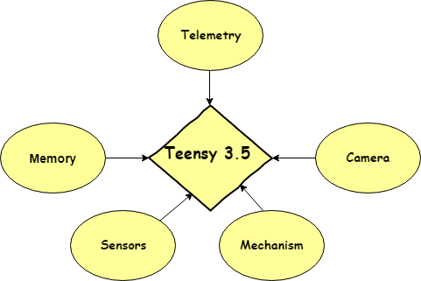
FSW Overview
Team Logo
Here
(If You Want)
Team 3
Basic FSW architecture, a flow chart showing how the software flow
Programming languages
Development environments
Brief summary of the FSW tasks
Program Language | Development Enviroment
C\C++ | Arduino IDE
Brief Summary Of FSW Tasks:
FSW get values from the sensors to send GCS and trigger the release and deployment. Also, it follows the stages of the flight and actives the sound after landing.
Presenter: Ulas Gulec

Slide 10
Part 1: Summary
GS
Team 3’s approach is not considered as it is too cluttered.
Ideal approach is a combination of Slides 1,2 & 3 of Team 1 and Slide 2 of Team 2. All required parameters will be fulfilled if we follow this approach.

Slide 11
Part 2: FSW Requirements
GS
The purpose of the table is to demonstrate to the judges that the team understands the requirements that apply to this sub-system
Overview of FSW sub-system requirements
Use bullets or a table to demonstrate an understanding of the mission requirements
This table may be expanded to multiple tables as needed
Clearly indicate:
Which Competition Guide Requirements are allocated to this subsystem
Any derived requirements for the subsystem

Slide 12
FSW Requirements (1/3)
Team Logo
Here
(If You Want)
Team 1
ID | Requirement | Rationale | Parent | Children | Priority | VM
 |  |  |  |  |  | A | I | T | D
FSW-1 | The science payload shall measure altitude using an air pressure sensor. | CReq | BR-20 | SS-6 CDH-1 | Very High | ✓ |  | ✓
FSW-2 | The science payload shall provide position using GPS. | CReq | BR-21 | SS-7 CDH-2 | Very High | ✓ |  | ✓
FSW-3 | The science payload shall measure its battery voltage. | CReq | BR-22 | SS-8 CDH-3 | Very High | ✓ |  | ✓
FSW-4 | The science payload shall measure outside temperature. | CReq | BR-23 | SS-9 CDH-13 | Very High | ✓ |  | ✓
FSW-5 | The science payload shall measure the spin rate of the auto-gyro blades relative to the science vehicle. | CReq | BR-24 | SS-10 CDH-5 | Very High | ✓ |  | ✓
FSW-6 | The science payload shall measure pitch and roll. | CReq | BR-25 | SS-11 CDH-6 | Very High | ✓ |  | ✓
Presenter: Altuğ ERTAN
12

Slide 13
FSW Requirements (2/3)
Team Logo
Here
(If You Want)
Team 1
ID | Requirement | Rationale | Parent | Children | Priority | VM
 |  |  |  |  |  | A | I | T | D
FSW-7 | The probe shall transmit all sensor data in the telemetry | CReq | BR-26 |  | Very High | ✓ |  | ✓
FSW-8 | The ground station shall be able to command the science vehicle to calibrate barometric altitude, and roll and pitch angles to zero as the payload sits on the launch pad. | CReq | BR-28 |  | Very High | ✓ |  | ✓
FSW-9 | Telemetry shall include mission time with one second or better resolution. Mission time shall be maintained in the event of a processor reset during the launch and mission. | CReq | BR-30 | CDH-9 | Very High | ✓ |  | ✓
FSW-10 | All telemetry shall be displayed in real time during descent. | CReq | BR-36 | GCS-3 | Very High | ✓ | ✓ | ✓
FSW-11 | All telemetry shall be displayed in engineering units (meters, meters/sec,Celsius, etc.) | CReq | BR-37 | GCS-4 | Very High | ✓ | ✓ | ✓
FSW-12 | The GPS receiver must use the NMEA 0183 GGA message format. | CReq | BR-53 |  | Very High | ✓ | ✓ | ✓
Presenter: Altuğ ERTAN
13

Slide 14
FSW Requirements (3/3)
Team Logo
Here
(If You Want)
Team 1
ID | Requirement | Rationale | Parent | Children | Priority | VM
 |  |  |  |  |  | A | I | T | D
FSW-13 | The flight software shall maintain a count of packets transmitted, which shall increment with each packet transmission throughout the mission. The value shall be maintained through processor resets. | CReq | BR-42 | CDH-4 | Very High | ✓ |  | ✓ | ✓
FSW-14 | An audio beacon is required for the payload. It may be powered after landing or operate continuously. | CReq | BR-47 | EPS-4 | Very High |  | ✓ |  | ✓
FSW-15 | Video shall be in color with a minimum resolution of 640x480 pixels and 30 fps. | Bonus Objective |  | SS-13 | High | ✓ | ✓ | ✓
FSW-16 | After the separation of container and payload at 450 meters, camera of the payload records a video during the descent and store the video to the SD Card. | Bonus Objective | SY-27 | SS-14 | High | ✓ |  | ✓
FSW-17 | The camera shall point downward 45 degrees from nadir of the science payload. | Bonus Objective | SY-28 | SS-15 | High | ✓ |  | ✓
FSW-18 | It shall point in one direction relative to the earth’s magnetic field with a stability of +/- 10 degrees in all directions during descent. | Bonus Objective | SY-29 | SS-16 | High | ✓ |  | ✓
Presenter: Altuğ ERTAN
14

Slide 15
FSW Requirements
Team Logo
Here
(If You Want)
Team 2
ID | Requirement | Rationale | Fulfillment | Priority | VM
 |  |  |  |  | A | I | T | D
9 | The container shall release the payload at 450 meters +/- 10 meters | Enables safe descent of SP. Competition requirement | Actions will be executed on this exact altitude based on barometer readings. Probe microcontroller will perform action via GPIO pins and HotWires. | High | x | x | x
20 | The science payload shall measure altitude using an air pressure sensor. | Allows SP to separate from container at required altitude, Competition requirement | Data will be collected from barometer via I2C line | High |  | x | x
21 | The science payload shall provide position using GPS. | Competition requirement | Coordinates will be collected from GPS via UART | High |  | x | x
22 | The science payload shall measure its battery voltage. | Competition requirement | Battery voltage will be read by ADC | High |  | x | x
23 | The science payload shall measure outside temperature. | Competition requirement | Data will be collected from sensor via 1-Wire interface | Medium |  | x | x
24 | The science payload shall measure the spin rate of the auto-gyro blades relative to the science vehicle. | Competition requirement | Data will be collected via GPIO pins from Hall sensor | Medium |  | x | x
25 | The science payload shall measure pitch and roll. | Enables using servos with ailerons for stabilisation, Competition requirement | Pitch and roll data will be collected continuously from IMU | High |  | x | x
26 | The probe shall transmit all sensor data in the telemetry | Competition requirement | Telemetry will be sent by Xbee module with 1Hz frequency | High | x | x | x
42 | The flight software shall maintain a count of packets transmitted, which shall increment with each packet transmission throughout the mission. The value shall be maintained through processor resets. | Competition requirement | Software counter will be maintained and incremented through all mission time. Value of the counter will be kept on memory card to survive processor restarts. | High | x | x | x
Presenter: Mateusz Rajzer

Slide 16
FSW Requirements
Team Logo
Here
(If You Want)
Team 3
 | Flight Sofware Requirements |  | Verification
ID | # of CR | Description | A | I | T | D
FSW-1 | 9 | The container shall release the payload at 450 meters +/- 10 meters. | ✓ |  |  | ✓
FSW-2 | 11 | The descent rate of the science payload after being released from the container shall be 10 to 15 meters/second. | ✓ |  |  | ✓
FSW-3 | 30 | Telemetry shall include mission time with one second or better resolution. Mission time shall be maintained in the event of a processor reset during the launch and mission. | ✓ | ✓
FSW-4 | 38 | Teams shall plot each telemetry data field in real time during flight. | ✓ |  |  | ✓
FSW-5 | 42 | The flight software shall maintain a count of packets transmitted, which shall increment with each packet transmission throughout the mission. The value shall be maintained through processor resets. | ✓
FSW-6 | 46 | The probe must include a power indicator such as an LED or sound generating device that can be easily seen without disassembling the cansat and in the stowed state. | ✓
FSW-7 | 47 | An audio beacon is required for the probe. It may be powered after landing or operate continuously. | ✓ |  |  | ✓
FSW-8 | 48 | The audio beacon must have a minimum sound pressure level of 92 dB, unobstructed. | ✓ | ✓
Presenter: Ulas Gulec

Slide 17
Part 2: Summary
GS
Either of Team 1,2 or 3’s approach can be used, depending on the volume of our requirements.
Prerequisite: An absolute understanding and vision of how the CanSat functions and how it is to be deployed is crucial and inevitable to make this part. Also, the corresponding guidelines which will be satisfied needs to be documented as well.

Slide 18
Part 3 : Payload FSW State Diagram
GS
Software state diagrams for Payload defining the states and transition conditions of the flight software
Include:
Sampling of sensors (including rates)
Communications (command and telemetry)
Data storage (if applicable)
Mechanism activations
Major decision points in the logic
Power management
FSW recovery to correct state after processor reset during flight
What data is used to recover?
Identify reasons for reset, and methods of recovery

Slide 19
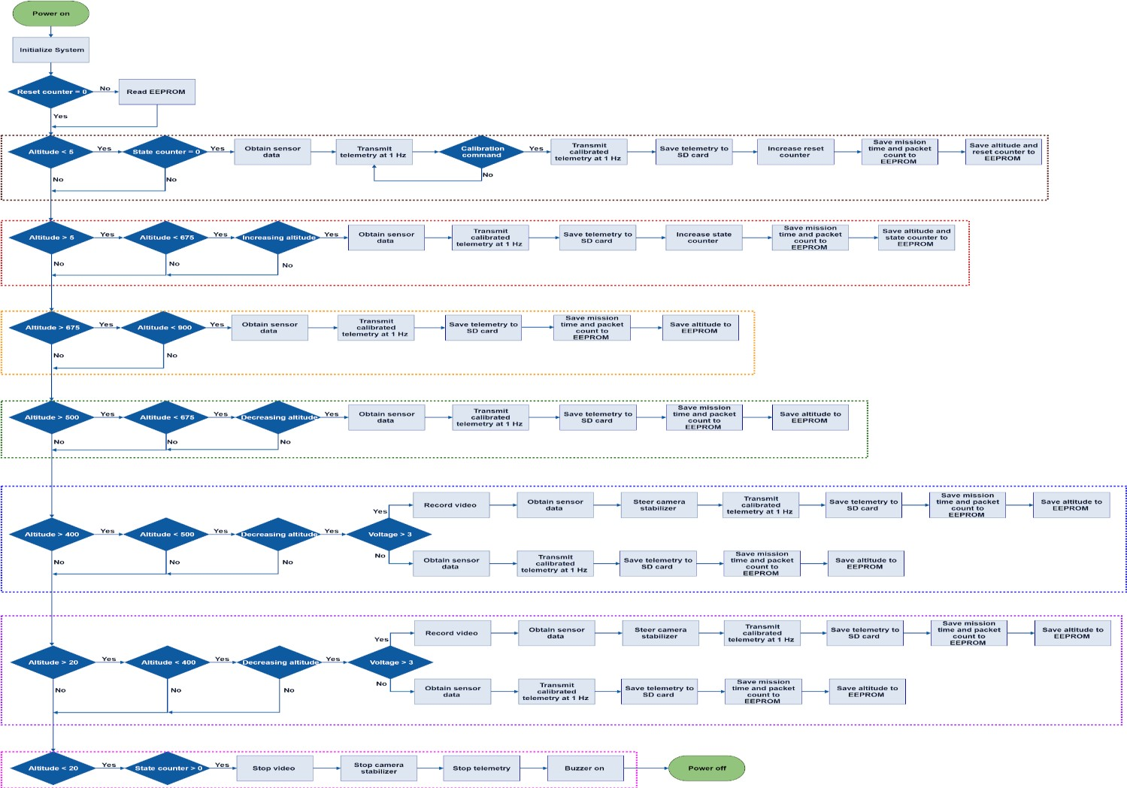
Payload FSW State Diagram (1/6)
Team Logo
Here
(If You Want)
Team 1
This slide shows the general flow of the payload flight software diagram. Diagram is divided into several parts for sharpness due to low quality view.
FSW States
Brown -- Launchpad Red -- Ascent Orange -- Apogee Green -- Descent
Navy Blue -- Separation
Purple -- Descent after separation
Pink -- Landing
General Diagram of the entire State and Transition Flow
Presenter: Altuğ ERTAN
19

Slide 20
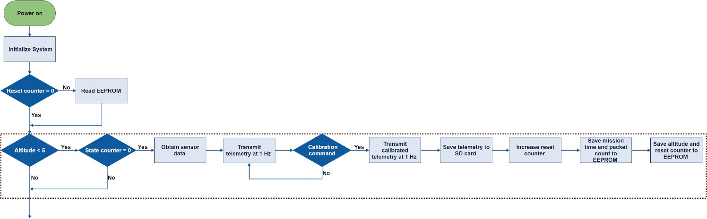
Payload FSW State Diagram (2/6)
Team Logo
Here
(If You Want)
Team 1
Individual Breakdown of the General Diagram
Brown -- Launchpad
Presenter: Altuğ ERTAN
20

Slide 21
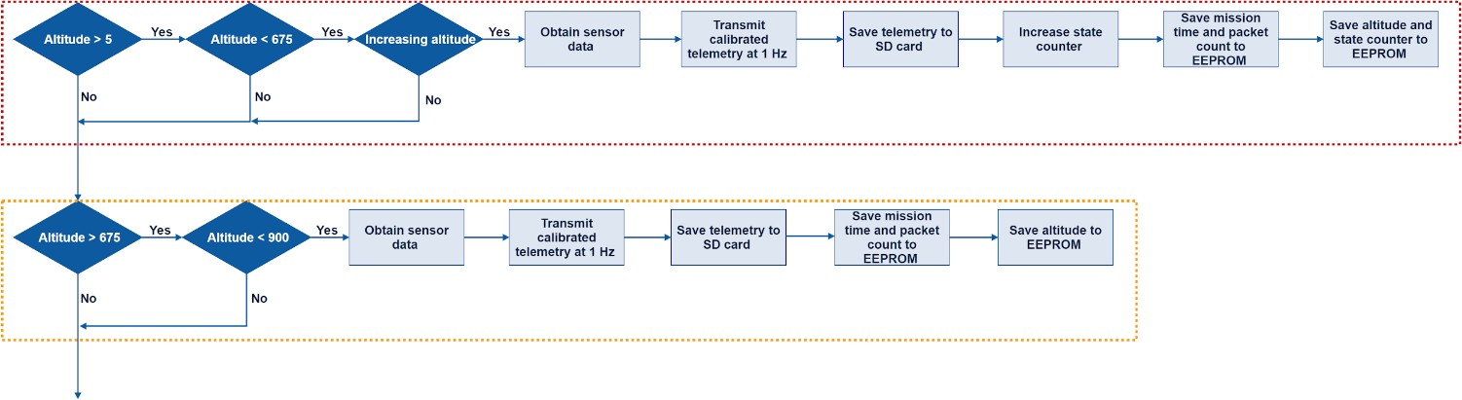
Payload FSW State Diagram (3/6)
Team Logo
Here
(If You Want)
Team 1
Individual Breakdown of the General Diagram
Red -- Ascent
Orange -- Apogee
Presenter: Altuğ ERTAN
21

Slide 22
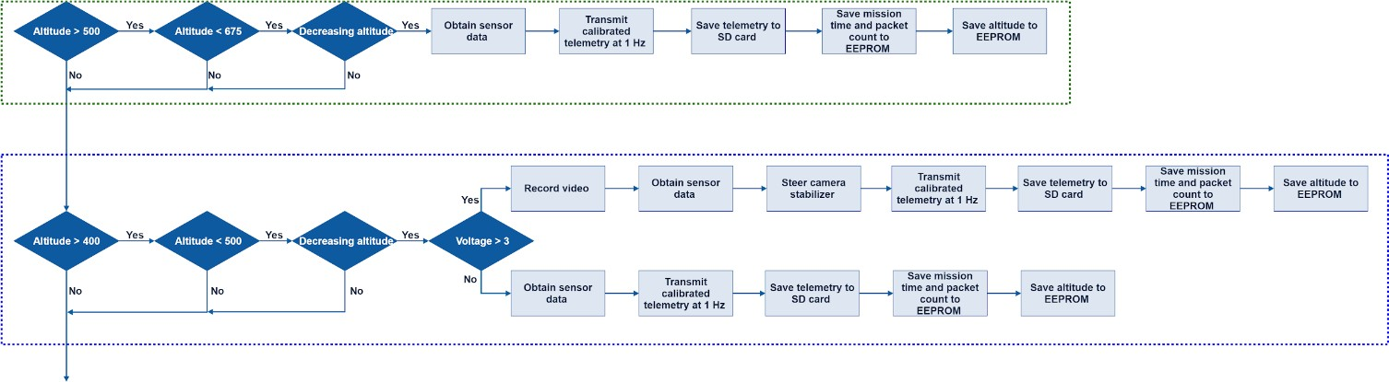
Payload FSW State Diagram (4/6)
Team Logo
Here
(If You Want)
Team 1
Individual Breakdown of the General Diagram
Green -- Descent
Navy Blue -- Separation
Presenter: Altuğ ERTAN
22

Slide 23
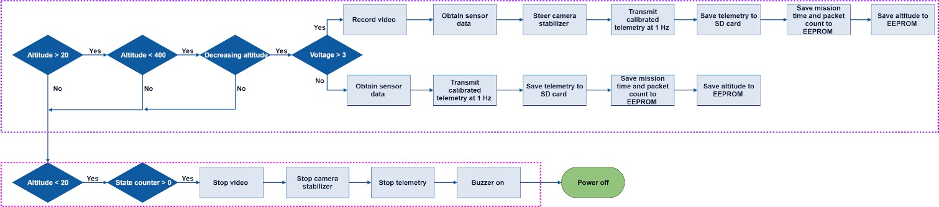
Payload FSW State Diagram (5/6)
Team Logo
Here
(If You Want)
Team 1
Individual Breakdown of the General Diagram
Purple -- Descent after separation
Pink -- Landing
Presenter: Altuğ ERTAN
23

Slide 24
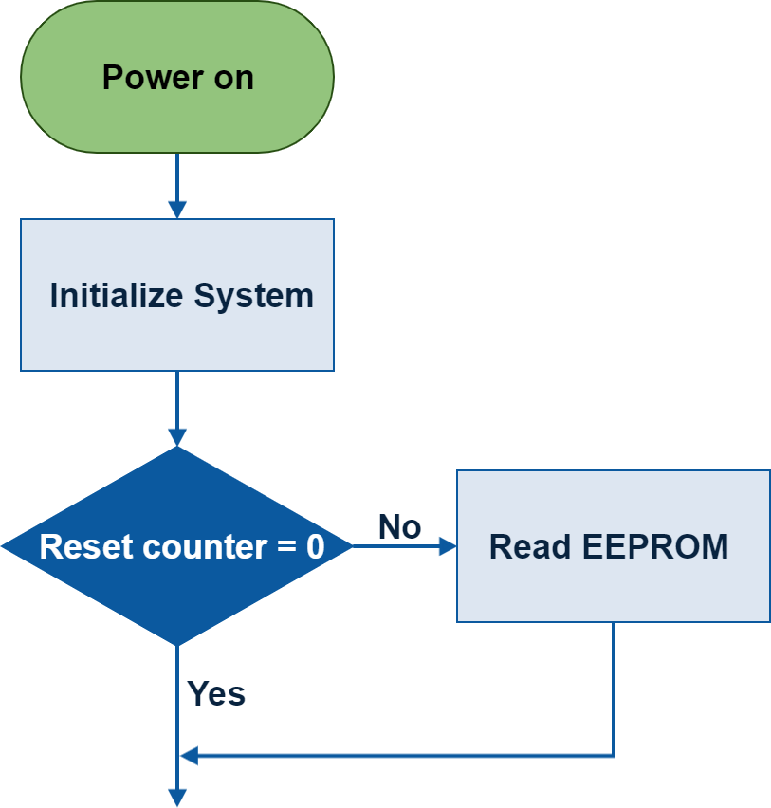
Payload FSW State Diagram (6/6)
Team Logo
Here
(If You Want)
Team 1
FSW recovery to correct state after processor reset during flight
Payload FSW State Recovery
Altitude data, reset counter and state counter variables will be used to recover FSW state if processor resets. Reset counter is an integer variable which helps to determine reset situation, and state counter is an integer variable which helps to determine software states.
Reset reasons may be high temperatures affecting directly to microprocessor, high current exceeding limits of input and output pins of microprocessor, and flight software which closes to flash memory limit of microprocessor.
Reset counter and state counter are increased in just first two states and save to EEPROM in these states. On the other hand, altitude data is saved to EEPROM in all states at every one second. If microprocessor resets, EEPROM is read based on the value of reset counter at beginning of the flight software. Thus, the value of the state counter and the last altitude data is obtained from EEPROM. As a result, according to values of state counter and last altitude data, the last software state will be found.
FSW state recovery part of flight software is shown.
Presenter: Altuğ ERTAN
24

Slide 25
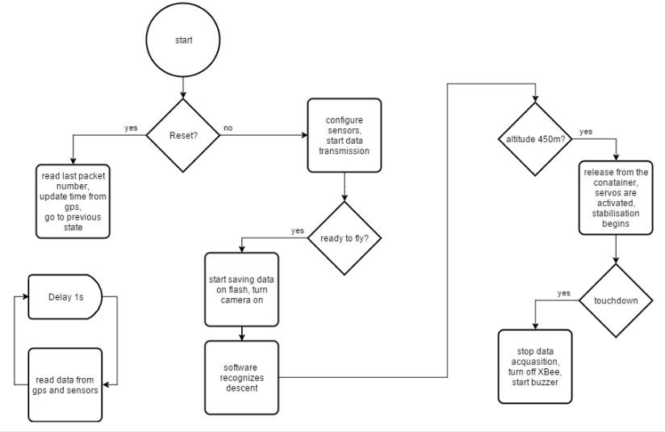
Payload FSW State Diagram 1/2
Team Logo Here
(If You Want)
Team 2
Software state diagrams for Payload defining the states and transition conditions of the flight software
Presenter: Mateusz Rajzer

Slide 26
Payload FSW State Diagram 2/2
Team Logo
Here
(If You Want)
Team 2
FSW recovery to correct state after processor reset during flight
As far as power management goes, all devices apart from two shall be turned on all the time. Said components are servos and hot wire. Their activation has been marked on flow diagram, and they are not to be turned off until end of the mission.
After reset of processor in flight mode, previous state of mission together with last paket count can be retrieved from flash. This information with current gps time is sufficient to continue mission. It must be mentioned, that gps has an external battery, which enables it to quickly recover from reset state and output accurate time.
Potential reset causes are countless, yet most likely of them are:
Temporary battery disconnection due to poor quality of connection,
Watchdog, triggered by software bug which caused program to freeze.
Presenter: Mateusz Rajzer

Slide 27
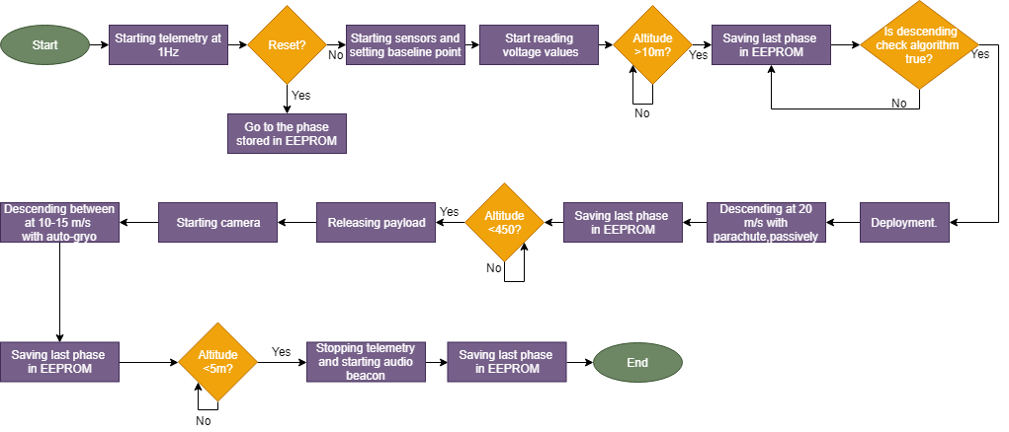
Payload FSW State Diagram
Team Logo
Here
(If You Want)
Team 3
All in One Slide which satisfies all the requirements of the part
Reset Control and Recovering: Each phases and packet countings are stored in EEPROM. If reset operation is done, microcontroller gets values from EEPROM for all datas. All datas, that are saved, are used for recovering.
All data is get from sensors with 4 Hz rate. Data is saved to SD Card. Data is sent to GCS with
telemetry.Sending packets are counted and saved to EEPROM.
Presenter: Ulas Gulec

Slide 28
Part 3: Summary
GS
Team 1 or 2’s approach can be used depending on the volume and approach to the requirements. Team 3’s approach is discarded as it is too cluttered.
Prerequisite: Again, an absolute understanding and vision of how the CanSat functions and how it is to be deployed is crucial and inevitable to make this part. Furthermore, there needs to be clarity on the individual subfunctions that the payload is supposed to carry out.

Slide 29
Part 4: Container FSW State Diagram
GS
Software state diagrams for Container defining the states and transition conditions of the flight software
Include:
Sampling of sensors (including rates)
Communications (command and telemetry)
Data storage (if applicable)
Mechanism activations
Major decision points in the logic
Power management
FSW recovery to correct state after processor reset during flight
What data is used to recover?
Identify reasons for reset, and methods of recovery
State is no container software

Slide 30
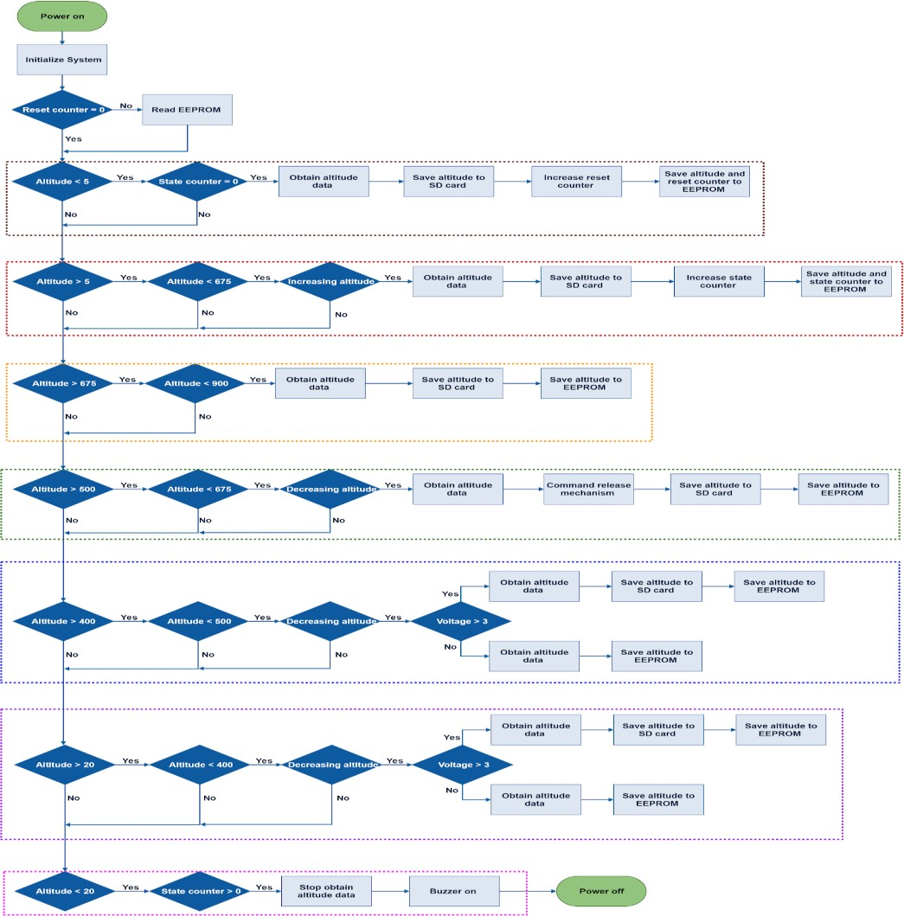
Container FSW State Diagram (1/6)
Team Logo
Here
(If You Want)
Team 1
This slide shows the general flow of the payload flight software diagram. Diagram is divided into several parts for sharpness due to low quality view.
FSW States
Brown -- Launchpad Red -- Ascent Orange -- Apogee Green -- Descent
Navy Blue -- Separation
Purple -- Descent after separation
Pink -- Landing
General Diagram of the entire State and Transition Flow
Presenter: Altuğ ERTAN
30

Slide 31
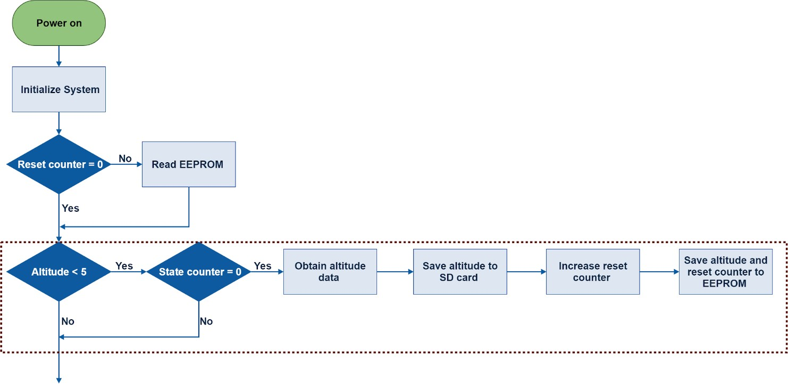
Container FSW State Diagram (2/6)
Team Logo
Here
(If You Want)
Team 1
Individual Breakdown of the General Diagram
Brown -- Launchpad
Presenter: Altuğ ERTAN
31

Slide 32
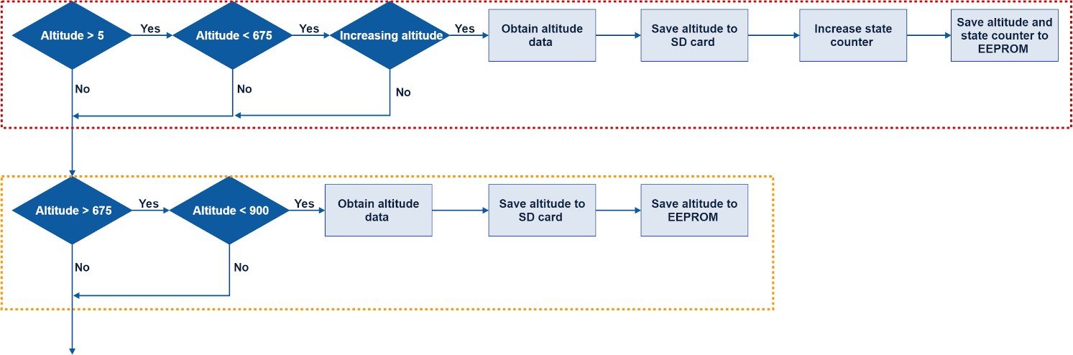
Container FSW State Diagram (3/6)
Team Logo
Here
(If You Want)
Team 1
Individual Breakdown of the General Diagram
Red -- Ascent
Orange -- Apogee
Presenter: Altuğ ERTAN
32

Slide 33
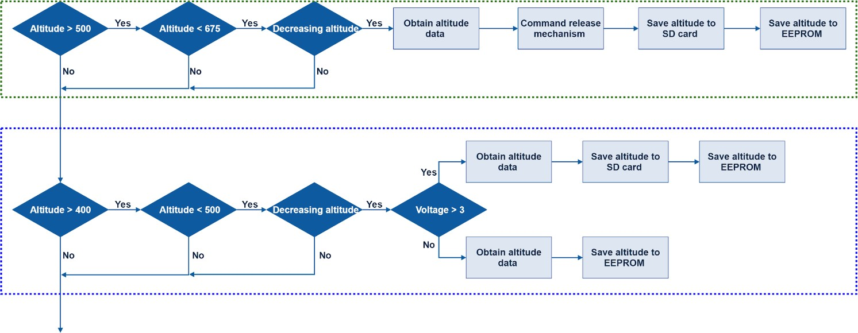
Container FSW State Diagram (4/6)
Team Logo
Here
(If You Want)
Team 1
Individual Breakdown of the General Diagram
Green -- Descent
Navy Blue -- Separation
Presenter: Altuğ ERTAN
33

Slide 34
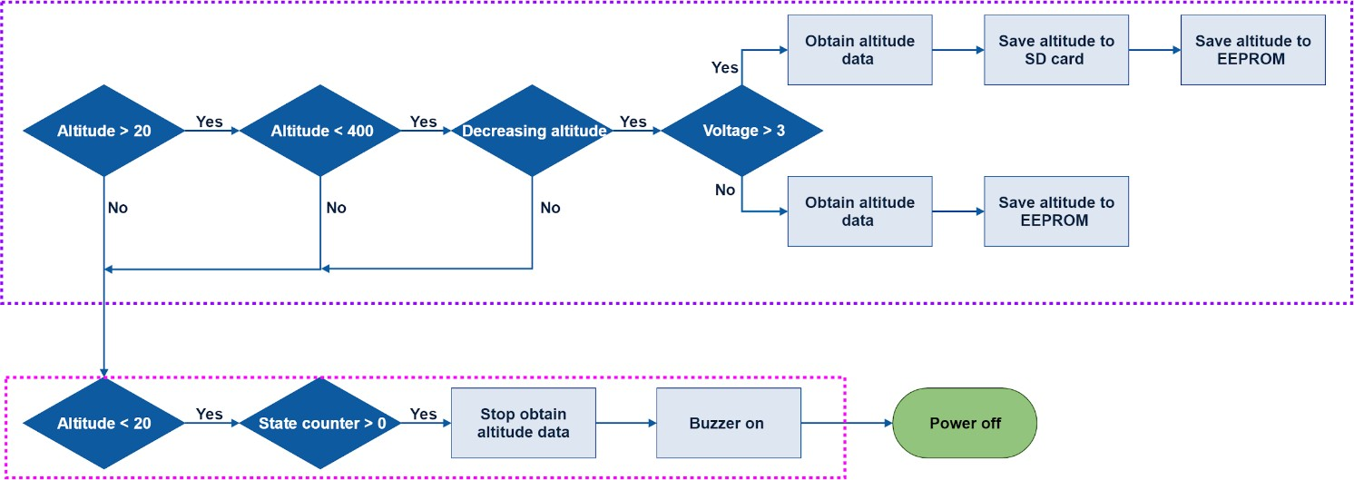
Container FSW State Diagram (5/6)
Team Logo
Here
(If You Want)
Team 1
Individual Breakdown of the General Diagram
Purple -- Descent after separation
Pink -- Landing
Presenter: Altuğ ERTAN
34

Slide 35
Container FSW State Diagram (6/6)
Team Logo
Here
(If You Want)
Team 1
FSW recovery to correct state after processor reset during flight
Container FSW State Recovery
Altitude data, reset counter and state counter variables will be used to recover FSW state if processor resets. Reset counter is an integer variable which helps to determine reset situation, and state counter is an integer variable which helps to determine software states.
Reset reasons may be high temperatures affecting directly to microprocessor, high current exceeding limits of input and output pins of microprocessor, and flight software which closes to flash memory limit of microprocessor.
Reset counter and state counter are increased in just first two states and save to EEPROM in these states. On the other hand, altitude data is saved to EEPROM in all states at every one second. If microprocessor resets, EEPROM is read based on the value of reset counter at beginning of the flight software. Thus, the value of the state counter and the last altitude data is obtained from EEPROM. As a result, according to values of state counter and last altitude data, the last software state will be found.
FSW state recovery part of flight software is shown.
Presenter: Altuğ ERTAN
35

Slide 36
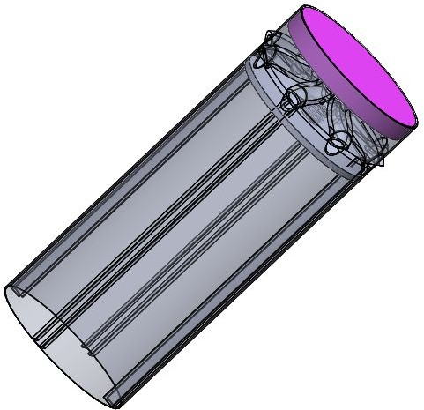
Container FSW State Diagram
Team Logo
Here
(If You Want)
Team 2
Since there are no electronics in this part for eam 2, this part does not require any clarification.
There are no electronics in the container
Presenter: Mateusz Rajzer

Slide 37
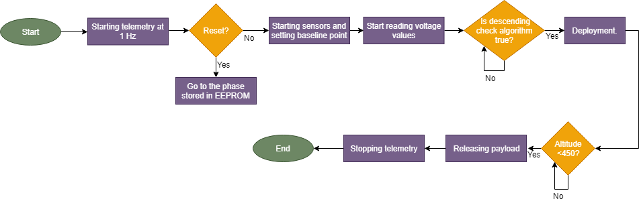
Container FSW State Diagram
Team Logo
Here
(If You Want)
Team 3
All in One Slide which satisfies all the requirements of the part
Reset Control and Recovering: Each phases and packet counting are stored in EEPROM. If reset operation is done, microcontroller gets values from EEPROM for all data. Pressure and voltage data, that are saved, are used for recovering.
Pressure and voltage data is get from sensors with 4 Hz rate. Data is saved to SD Card. Data is sent to GCS with telemetry. Sending packets are counted and saved to EEPROM.
Note : We do not aim to use flight software diagram for container. If we will face any problem during our
tests, we would use this flight software diagram for container.
Presenter: Ulas Gulec

Slide 38
Part 4: Summary
GS
Team 1’s approach is ideal. Team 3’s approach is discarded as it is too cluttered.
Prerequisite: Again, an absolute understanding and vision of how the CanSat functions and how it is to be deployed is crucial and inevitable to make this part. Furthermore, there needs to be clarity on the individual subfunctions that the container is supposed to carry out.

Slide 39
Part 5: Software Development Plan
GS
A common CanSat problem is late software development
Present a slide describing the plan for software development and plans to reduce the risk of late software development
Include:
Prototyping and prototyping environments
Software subsystem development sequence
Development team
Test methodology

Slide 40
Software Development Plan (1/4)
Team Logo
Here
(If You Want)
Team 1
Prototyping and Prototyping Environments
Prototyping and Prototyping Environments
Each sensor is tested on breadboard by supplying required power voltage and obtained data are
evaluated on serial monitor of Arduino IDE.
All sensors are brought together on breadboard by supplying required power voltage and a prototype of payload circuit is formed. Obtained data are evaluated on serial monitor of Arduino IDE.
Boot time of microprocessor is measured by uploading blink code to the microprocessor. Thus, at the first moment when LED is on is measured by using a stopwatch after supplying power to the microprocessor.
A prototype circuit will be built for 3-axis camera stabilizer on breadboard, so reaction time and rotation speeds of motors with respect to changing angles will be determined.
A prototype circuit of the container will be formed on a breadboard by using a barometric sensor and an N-channel MOSFET for testing the time required to melt fishing line connected to nichrome wire and determining whether separation works properly.
Presenter: Altuğ ERTAN
40

Slide 41
Software Development Plan (2/4)
Team Logo
Here
(If You Want)
Team 1
Breakdown of Software Subsystem Development Sequence
Software Subsystem Development Sequence (Payload)
Task List | Situation | Deadline
Selection of sensors for mission requirements. | Completed | Early October
Library researching and code modifications for each sensor. | Completed | Mid October
Testing of each sensor individually with microcontroller. | Completed | Early November
Calibration of each sensor and repairing codes according to tests. | Completed | Late November
Bringing each sensor code together and testing all sensors simultaneously. | Completed | Mid December
Using of EEPROM for recovery of mission time,packet count and flight software data . | Completed | Late December
Wired serial communication test with ground station prototype. | Completed | Mid January
Storage of telemetry to SD Card. | Completed | Late January
Calibration command for altitude,pitch and roll data at launchpad. | In progress | Mid February
Recording video by using camera and storing the video to SD Card. | Not started | Late February
Magnetometer data analysis and calibration for bonus objective. | Not started | Early March
Coding of servo and stepper motors for camera stabilizer with respect to varying gyroscope and magnetometer data. | Not started | Early March
PCB and software compatibility test. | Not started | Mid March
Testing 3-axis camera stabilizer by bringing all components together. | Not started | Mid March
Wireless communication test with ground station. | Not started | Late March
Presenter: Altuğ ERTAN
41

Slide 42
Software Development Plan (3/4)
Team Logo
Here
(If You Want)
Team 1
Breakdown of Software Subsystem Development Sequence
Software Subsystem Development Sequence (Container)
Task List | Situation | Deadline
Selection of barometer sensor. | Completed | Early October
Library researching and code modifications for barometer sensor. | Completed | Mid October
Testing of barometer sensor individually with microcontroller. | Completed | Early November
Calibration of barometric sensor and repairing code according to tests. | Completed | Late November
Storage of altitude data to SD Card. | Completed | Late January
Algorithm of separation mechanism at 450 meters. | In progress | Late February
MOSFET logic signal efficiency test to melt the fishing line for separation mechanism. | Not started | Early March
PCB and software compatibility test. | Not started | Mid March
Presenter: Altuğ ERTAN
42

Slide 43
Team Logo
Here
(If You Want)
Software Development Plan (4/4)
Team 1
Breakdown of Test Methodology and Development Team
Test Methodology
Meteorology Observation Park located in Aeronautics and Astronautics faculty of ITU are used for testing air pressure and air temperature values.
Obtained longitude and latitude values from GPS sensor are controlled on Google Maps.
RPM value is measured by a real tachometer and it is compared with the data generated by blade spin rate sensor.
Power Bus voltage is measured by a real multimeter and it is compared with the data obtained
by analog pin of the Teensy 3.5.
Magnetometer calibration test will be held at Upper Atmosphere and Space Air Laboratory located in Aeronautics and Astronautics faculty of ITU.
Telemetry transmission test will be done between the two sides of Bosphorus which have the
distance of 1.6 km.
At 200 meters a free falling test will be conducted at ITU stadium, so flight software will be examined in terms of corporation with other subsystems.
Development Team
Altuğ ERTAN
Resul DAGDANOV
Presenter: Altuğ ERTAN
43

Slide 44
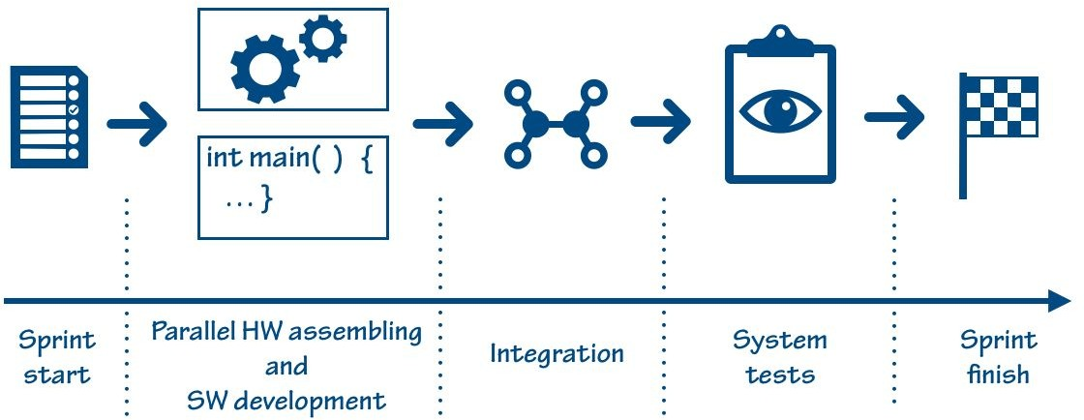
Software Development Plan 1/2
Team Logo
Here
(If You Want)
Team 2
Plan for software development and plans to reduce the risk of late software development
Agile development and integration strategy
All software tasks, based on requirements will be listed and described in project’s backlog. Storing tasks in backlog will be connected with categorization. Each division will be linked with one functionality of CanSat, for example: main state machine, IMU measurements, communication, heat shield actions, etc.
To prevent late software development we decided to develop each section described above parallely with hardware components mounting.
Each software/hardware division is being developed in separate Agile’s methodology sprints (1-2 weeks). Meantime the sprint software and hardware section will be developed simultaneously. Sprint finishes when both sections are completely tested and cooperate with each other.
This strategy allows us not to delay SW development on account of hardware assembling. In effect, at the end of each sprint we acquire new functionality both on hardware and software sides.
Presenter: Mateusz Rajzer

Slide 45
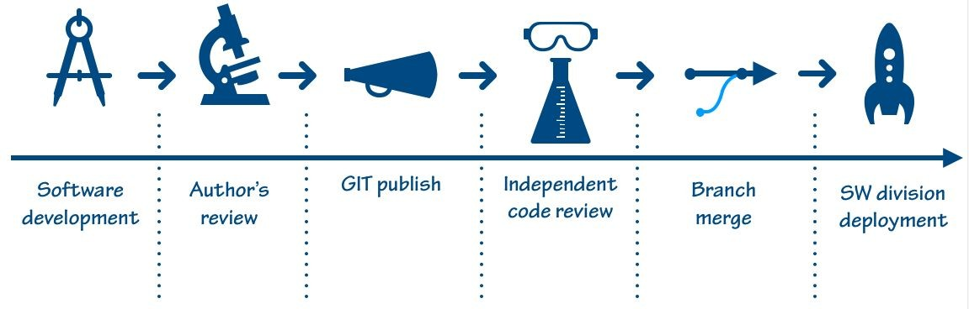
Software Development Plan 2/2
Team Logo
Here
(If You Want)
Team 2
Breakdown of Software Subsystem Development Sequence
Code publishing and reviewing process
In each sprint, one division from Software Development Plan will be completed.
SW developer can work on one task, chosen from current sprint’s division.
Finished code, after author’s revision will be published into the GIT repository on private developer’s branch.
Each committed change needs to be reviewed by independent tester.
After positive result of code review (desk check) and compilation verification, developer’s branch can be merged into master branch.
Before closing the sprint, all committed changes will be integrated into existing software from previous sprint. At this point, system tests will be performed. In test procedure development teams will test functionality of the software division and cooperation with whole software system.
Presenter: Mateusz Rajzer

Slide 46
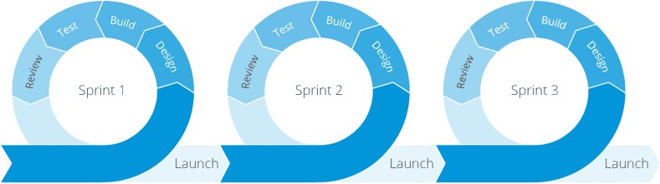
Software Development Plan
Team Logo
Here
(If You Want)
Team 3
Plans to reduce the risk of late software development
Avoiding Late Software Development:
We will use Agile development methodology. We will divide the project into the sprints. Each sprint will be tested and verified at the end
other development phase. Therefore, risk of late software
development will be eliminated.
Software Subsystem Development Sequence:
Presenter: Ulas Gulec

Slide 47
Software Development Plan
Team Logo
Here
(If You Want)
Team 3
Breakdown of Prototyping and Prototyping Environments, Test Methodology and Development Team
Prototyping and Prototyping Environments:
Breadboard will be used for prototyping.After that, the circiut board will be printed on PCB. Then, software will be run with temporary values.
Test Methodology:
Each component will be tested seperately. When iteration of any integration is done, tests will be done again such as; free-fall drop test, communication test, debugging, power test.
Development Team:
Ulaş GÜLEÇ
Haluk Levent ÇİÇEK
Presenter: Ulas Gulec

Slide 48
Part 5: Summary
GS
Any of team 1,2 or 3’s approach can be used, as per our plan.
Prerequisites:
A clear plan on how the software to be used for the Cansat will be developed, along with the projected timeline of the development process.
A clear idea of the techniques which will be used for testing our software (Test methodology).

Slide 49
END

